Slide 1
Contact + Source
Blog: www.raymondcamden.com
Email: raymondcamden@gmail.com
Twitter: raymondcamden
Source (slides + code): https://github.com/cfjedimaster/webtask-serverless-preso

Slide 2
Serverless with Webtask
Section 1 – Defining Serverless
Notes:
So welcome to the ‘what is’ section and let me start off with a warning. A lot of what follows will be opinion. You will find people who talk about the same topics I’m going to talk about who bring their own, probably conflicting, ideas, and that’s totally cool. My goal here is to talk about serverless and what it means to me.

Slide 3
What it is…
A term very much in flux!
A simpler, more effective way to build functionality
Notes:
#1 is – this term means different things to different people.
#2 – I want to stress that word functionality as opposed to “applications”

Slide 4
What it is…
“Serverless computing refers to a model where the existence of servers is simply hidden from developers. I.e. that even though servers still exist developers are relieved from the need to care about their operation. They are relieved from the need to worry about low-level infrastructural and operational details such as scalability, high-availability, infrastructure-security, and so forth.”
Credit: https://developer.ibm.com/openwhisk/what-is-serverless-computing/

Slide 5
What it is…
Node PaaS services
Database as a Service
Static site services
Notes:
Now (now.sh)
Mlab – although I still have to think about a sever address, auth, etc
Netlify

Slide 6
“Function as a Service”
I write a function and it does one thing
The actual hosting of the function, the making it available, is handled by the service
I call my function
“Details”

Slide 7
What you get…
Small, atomic services
Composition (typically)
Cheaper costs (pay when used)

Slide 8
What it isn’t…
The answer to everything!
Easier (always)
Cheaper (always)

Slide 9
Where does this make sense?
You’re building simple, small services that do one thing
Usage isn’t 24/7
Fine grained details aren’t important

Slide 10
Where doesn’t it make sense…
You’re building a server!
You have near constant usage
You end up with huge “functions” thousands of lines long

Slide 11

“It Depends”
Notes:
And then finally – it may end up being somewhat gray. It works for you doing X, but not for another team doing the exact same thing
One thing to note is that it’s not like it’s loss time per se. You write your serverless function – that logic can be reused

Slide 12
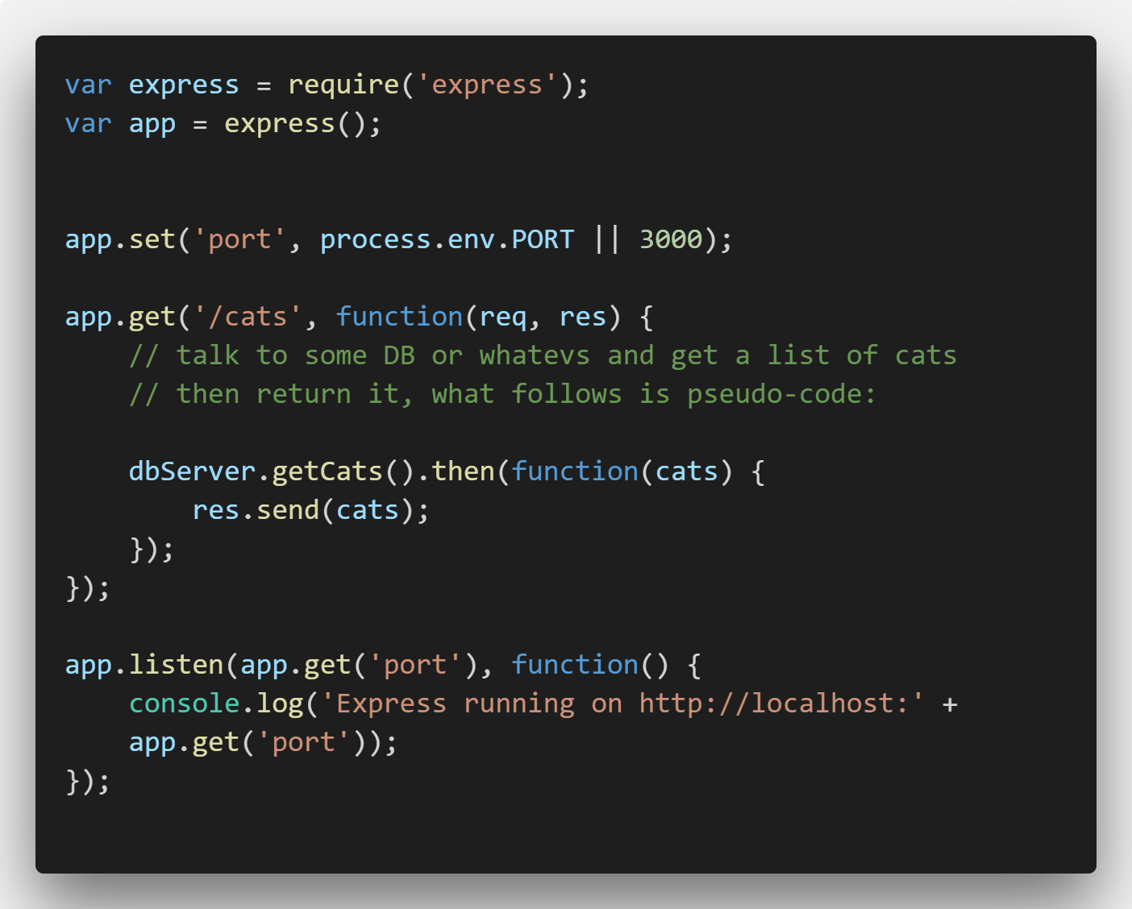
An Example (This is what excites me!)

Slide 13
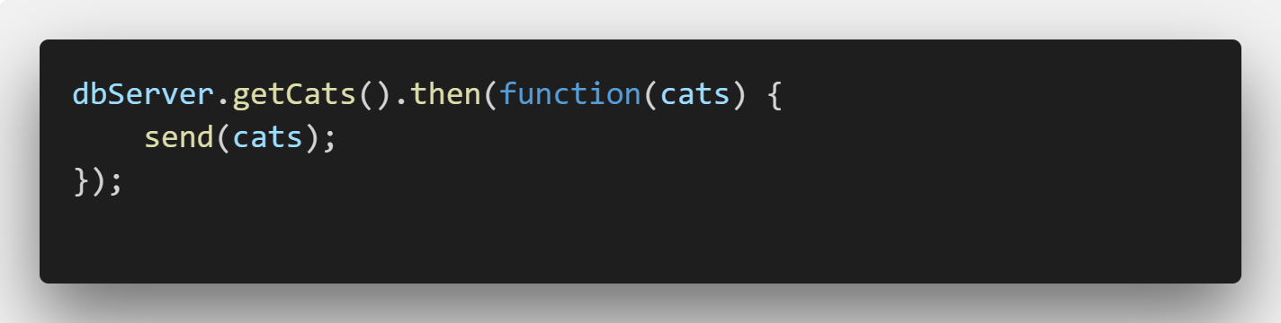
An Example (Again – kinda fake!)

Slide 14
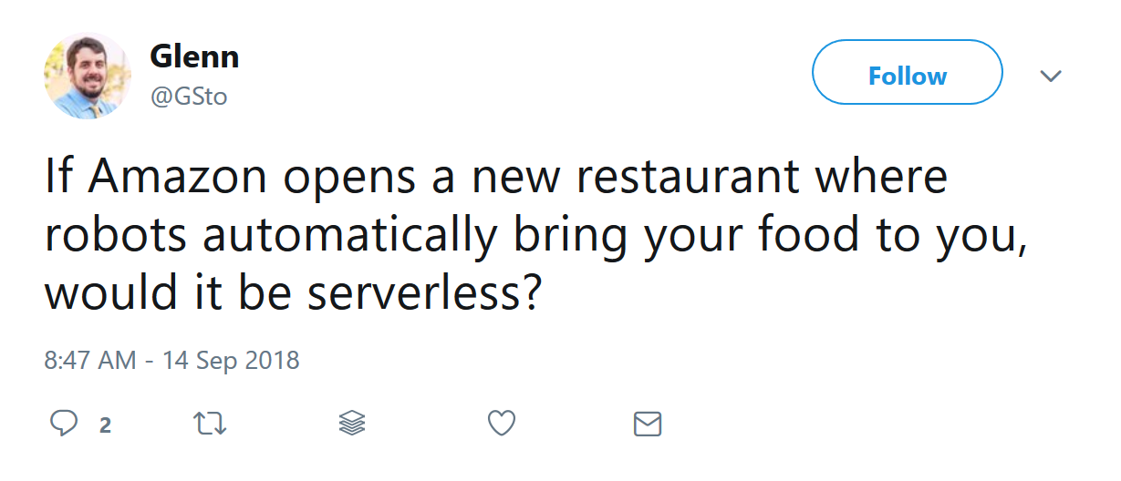

Slide 15

Options…

Slide 16
Apache OpenWhisk
Open source
Multi-language platform (Node, Swift, Java, Go, Scala, Python, PHP, Docker)
Significant supporters (Adobe, IBM, Red Hat, and more…)
openwhisk.apache.org

Slide 17
IBM Cloud Functions
Apache OpenWhisk
UI for editing, monitoring, etc
Visual composer for building complex serverless apps
https://console.bluemix.net/openwhisk/
https://www.raymondcamden.com/tags/openwhisk/

Slide 18
OpenWhisk/IBM Cloud Functions
Pros:
Relatively simple programming interface
Easy to get a URL
Free
Cons:
Initial setup is a bit of work

Slide 19
Azure Functions
Part of Azure
Feature rich
Multi-language: JavaScript, C#, F#, JavaScript
Experimental: Bat, Python, PowerShell, TypeScript
UI for editing, CLI too (somewhat awkward)
https://azure.microsoft.com/en-us/services/functions/
https://www.raymondcamden.com/tags/azure/

Slide 20
Azure Functions
Pros
Good integration with Azure itself
Good Visual Studio Code integration
Cons
A bit tricky to setup locally
Not 100% free to test

Slide 21
Google Cloud Functions
Part of Google Cloud
Node 6, 8 (Beta), Python (Beta)
Online console and CLI
https://cloud.google.com/functions/

Slide 22
Amazon Lambda
I bet you’ve heard of this one…
Incredibly powerful
Incredibly complex
https://aws.amazon.com/lambda/

Slide 23
Serverless Platform
Not another option!
A framework on top of serverless called… Serverless
CLI for scaffolding, deploying, testing
Yaml file for configuration, deployment, etc
https://serverless.com

Slide 24
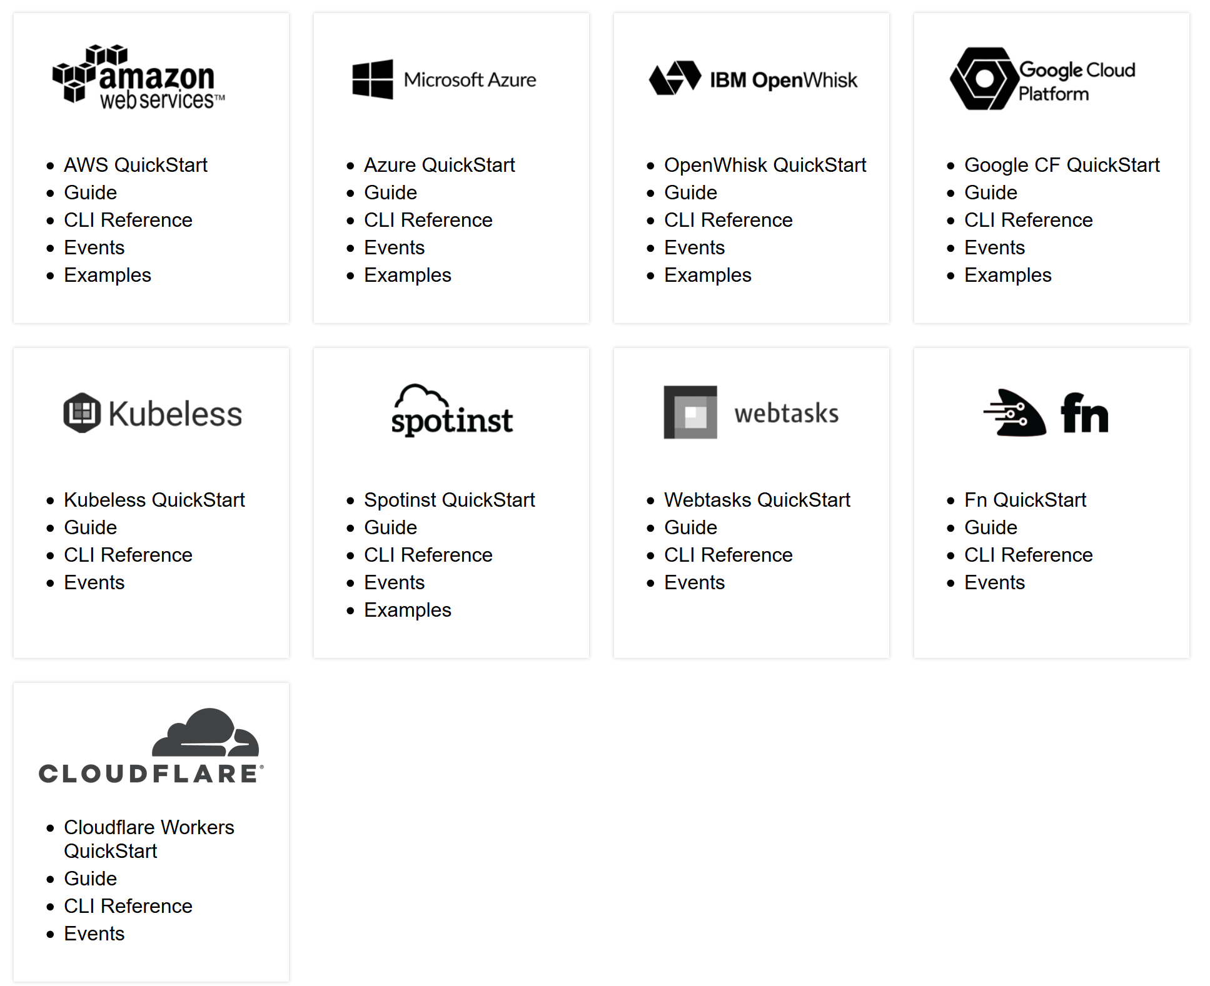
Serverless Platform

Slide 25
More…
“Targeted” Serverless Features
Twilio Functions
MongoDB Stitch
GitHub Actions
Extend (goextend.io)

Slide 26
Webtask!
Next section! ;)

Slide 27
Serverless with Webtask
Section 2 – Using Webtask
Notes:
So welcome to the ‘what is’ section and let me start off with a warning. A lot of what follows will be opinion. You will find people who talk about the same topics I’m going to talk about who bring their own, probably conflicting, ideas, and that’s totally cool. My goal here is to talk about serverless and what it means to me.

Slide 28
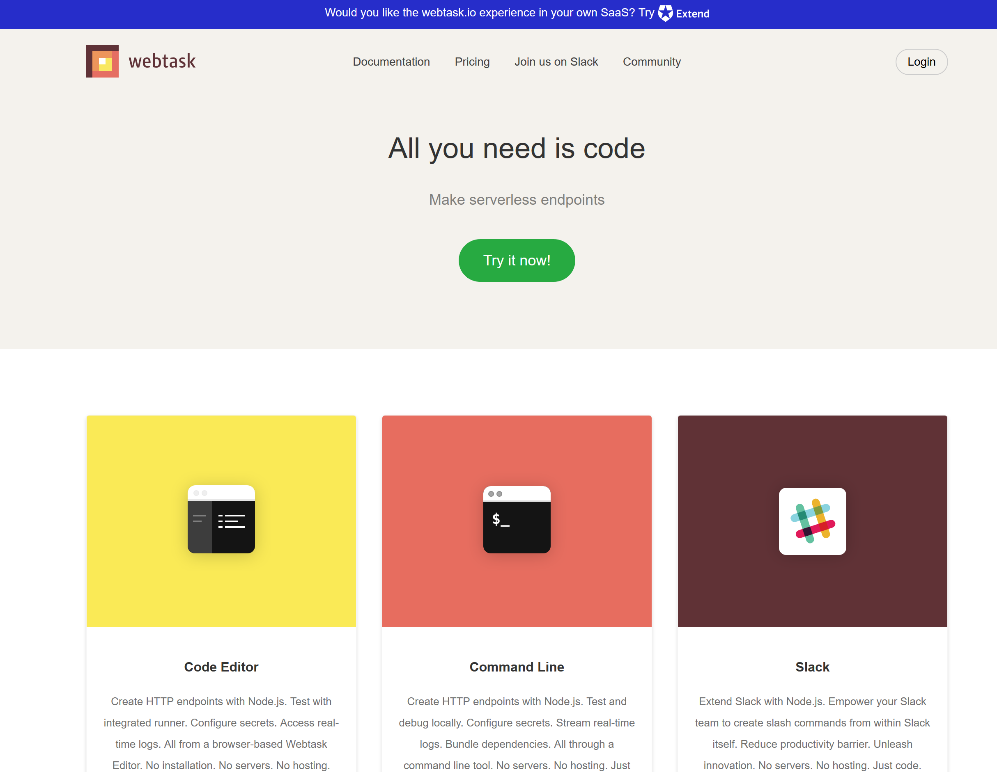
Signing Up
No credit card!
Login options: Facebook, Google, GitHub, and Microsoft

Slide 29
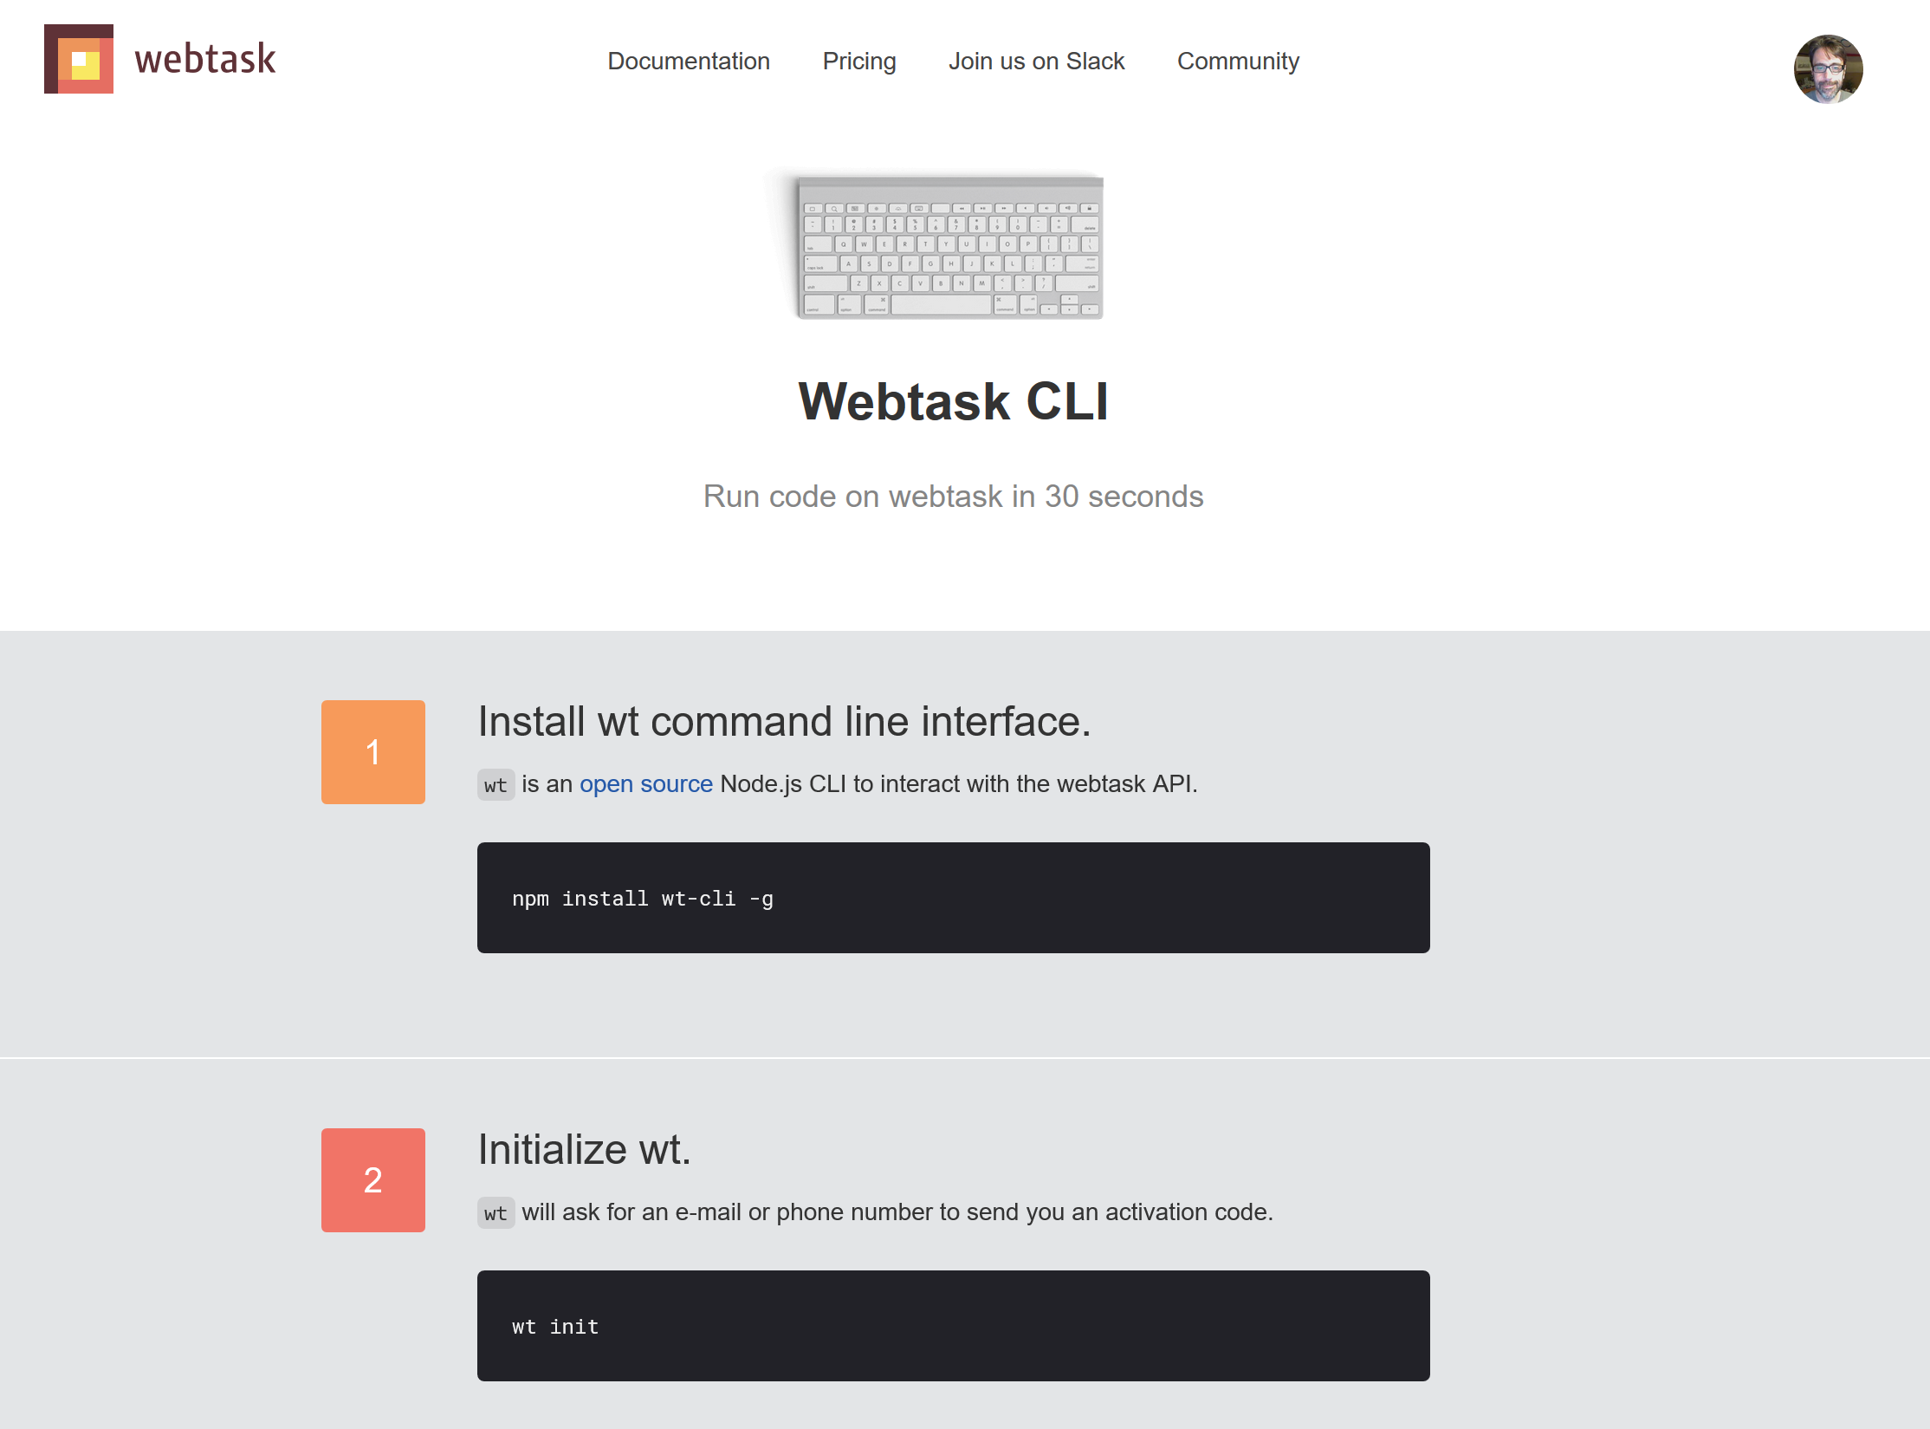
Signing Up
Notes:
Now – one weird thing is that Webtask has a freaking cool online editor. But it’s not mentioned at all here. The CLI is great, you should install it too, but for this session we’re going to be focusing on the online editor to make things as easy as possible. But like I said – even though I love my editor and ALWAYS default to it, the online editor is good enough to make me break my own rule for it.
So how do you get there?

Slide 30
The Editor!
https://webtask.io/make
List your files (and search)
Make new files (and delete stinky old ones)
Open files (duh), edit, full screen
Syntax highlighting, ESLint, Prettier
Dark theme!
Oh, and a full testing environment

Slide 31
The Editor!
Notes:
Demo
Show list of files,
Show ctrl+p to search for alexa
Open 2 files
Show code complete (setTim
Note dirty indicator
Show link at the bottom
Show runnin and logs

Slide 32
Writing Webtasks
Three basic "forms" to follow
JavaScript
Simple to Hipster Fancy Stuff

Slide 33
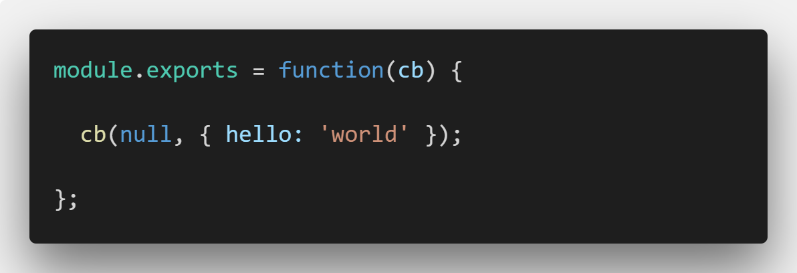
Basic Function Form
Notes:
Pearson_c2_basic

Slide 34
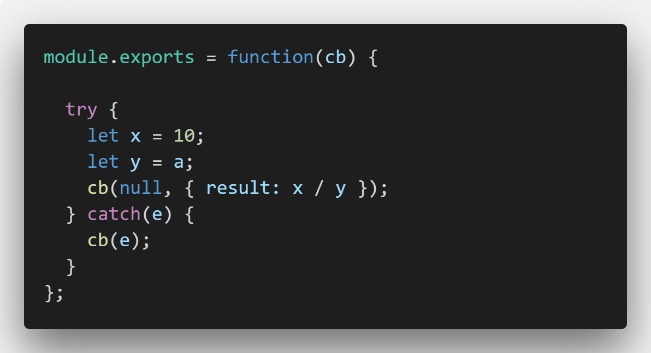
Basic Function Form
Notes:
Pearson_c2_error.js

Slide 35
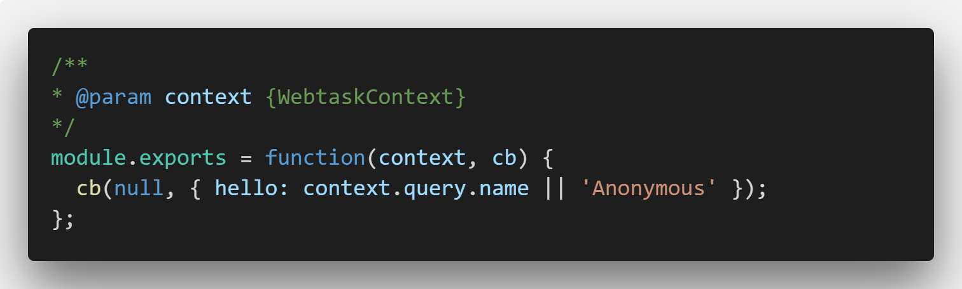
Context Form
Notes:
Show typing ‘context’ in editor and how it prompts

Slide 36
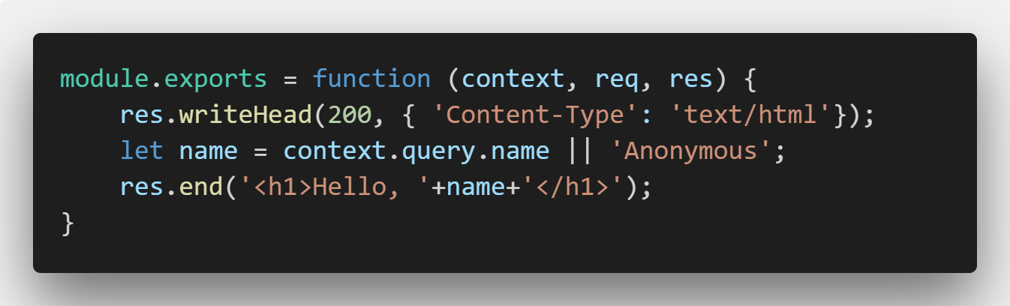
Full HTTP Control
Notes:
Show example obviously

Slide 37
Exercise One – Pig Latin
Translate an English word to Pig Latin
Take first consonant, moves it to the end, and adds “ay”. Or if the word begins with a vowel, add “way” to the end
https://forum.freecodecamp.org/t/freecodecamp-algorithm-challenge-guide-pig-latin/16039
Create a front end (jQuery, Vue, vanilla JS, anything)

Slide 38

Break

Slide 39
Serverless with Webtask
Section 3 – Deeper into Webtask

Slide 40
The Context Object
Query params
Body params
Headers
Meta
Secrets

Slide 41
Query params
Query string parameters
foo.com/search?name=ray&age=20
Useful for GET requests
Parsed by NPM module querystring – not qs.
context.query = { name: ray, age: 20 }
Notes:
Remind about max size
Example – pearson_s3_

Slide 42
Query params - Examples
pearson_c3_qs1
pearson_c3_qs2

Slide 43
Body params
Either form fields
Or application/json POSTed info
Useful for POST requests
context.body

Slide 44
Body params - Examples
pearson_c3_body1
pearson_c3_body2
pearson_c3_body2fixed
Notes:
for body2, do a form post and note its undefined

Slide 45
Header params
HTTP headers
Useful for reading HTTP headers (sorry!)

Slide 46
Header params - Examples
pearson_c3_header1

Slide 47
Meta params
Metadata
No real impact on your code (unless you allow it)
Defined in UI or via cli
context.meta

Slide 48
Meta params - Examples
pearson_c3_meta1

Slide 49
Secret params
Are secret
Perfect for API keys
Your code can still expose them!
context.secrets
Notes:
don’t skip

Slide 50
Secret params - Examples
pearson_c3_secret1

Slide 51
Exercise 1 – Super Pig Latin App
Convert previous example to assume a large body of text
Take each word and translate
Return new string of pig latin

Slide 52
Break

Slide 53
Serverless with Webtask
Section 4 – Storage

Slide 54
Webtask Storage
Very, very lightweight persistence system
One big JSON object
No query, no filtering, just a blob of data
Conflict detection (resolution is up to you)
UI support
You can still use “real” persistence

Slide 55
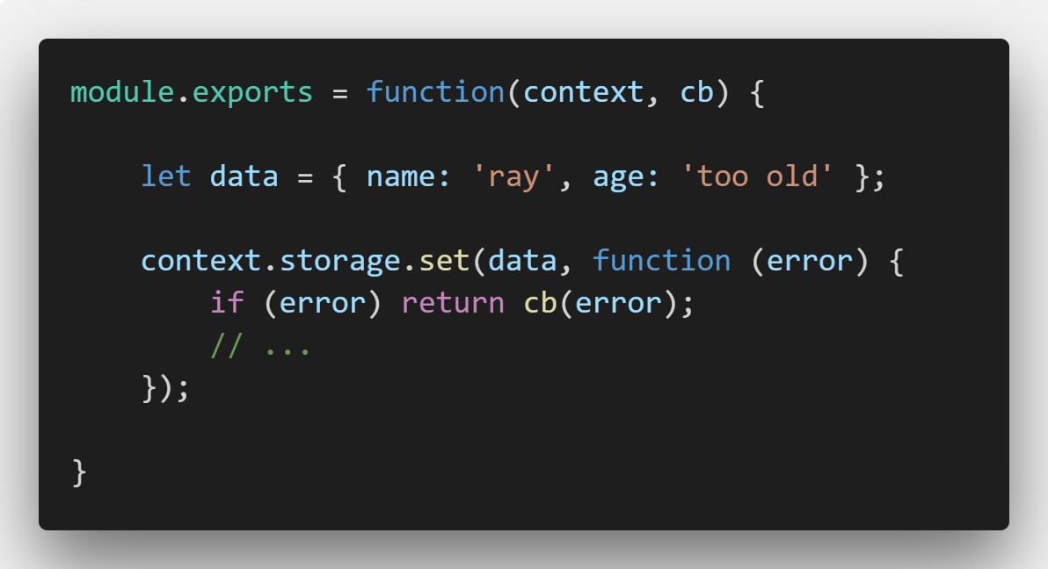
Webtask Storage - Writing

Slide 56
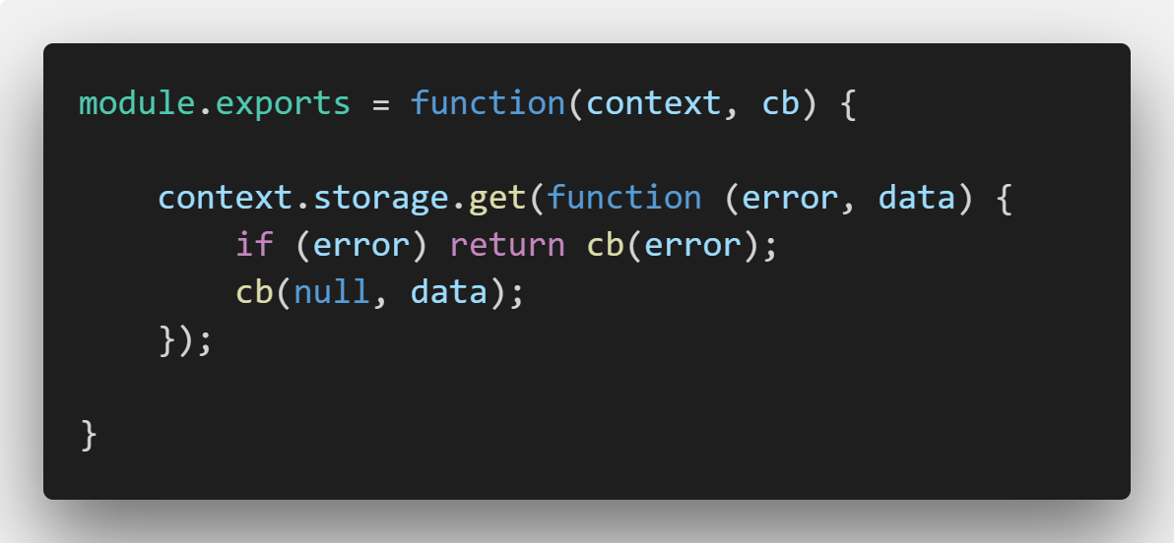
Webtask Storage - Reading

Slide 57
Webtask Storage - Examples
pearson_c4_readwrite

Slide 58
Handling Conflicts
Do “something” and run your set operation again
Force your updates
Notes:
Taken from the docs

Slide 59
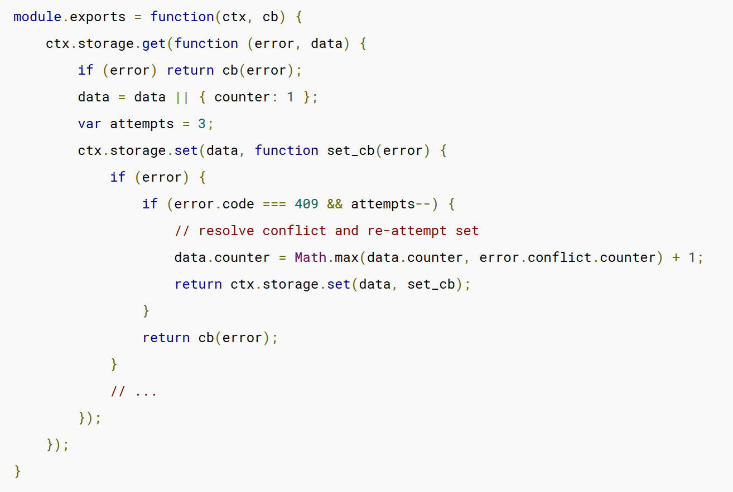
Handling Conflicts - Manually

Slide 60
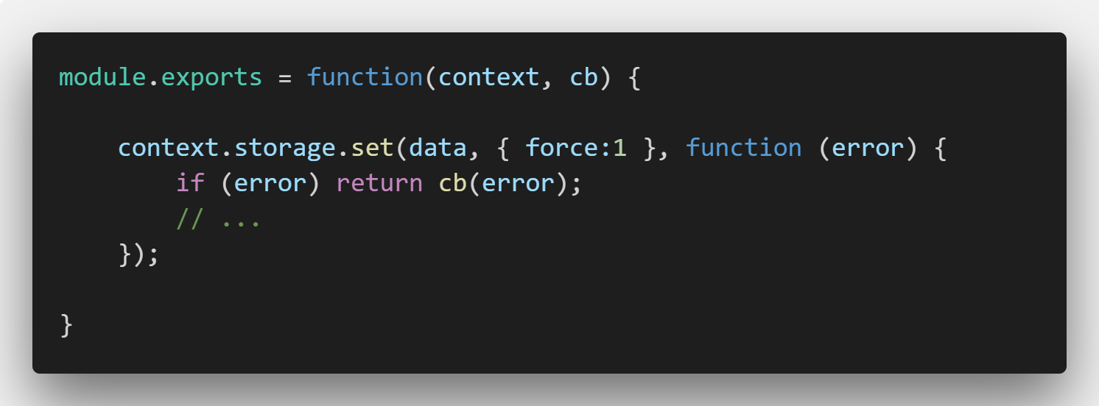
Handling Conflicts - Forced

Slide 61
Exercise 1 – Score Keeper
API accepts a “score” for a game (1-10)
Webtask will remember total number of games, total points
Returns total number of games and average score

Slide 62
Break

Slide 63
Serverless with Webtask
Section 5 – NPM Modules

Slide 64
NPM Modules
Libraries of functionality
Primary way of sharing code for Node-based applications
(Heck of a lot more that I’m not covering here…)
Webtask: Editor and CLI support

Slide 65
NPM Modules via CLI
Command line automatically detects a package.json
Also supports --dependency flag
--dependency request@2

Slide 66
Editor Support
Tool for managing NPM modules (add, edit version, delete, search)
Auto-detection in code

Slide 67
Demo
pearson_c5_npm
Notes:
This one is NOT in source control

Slide 68
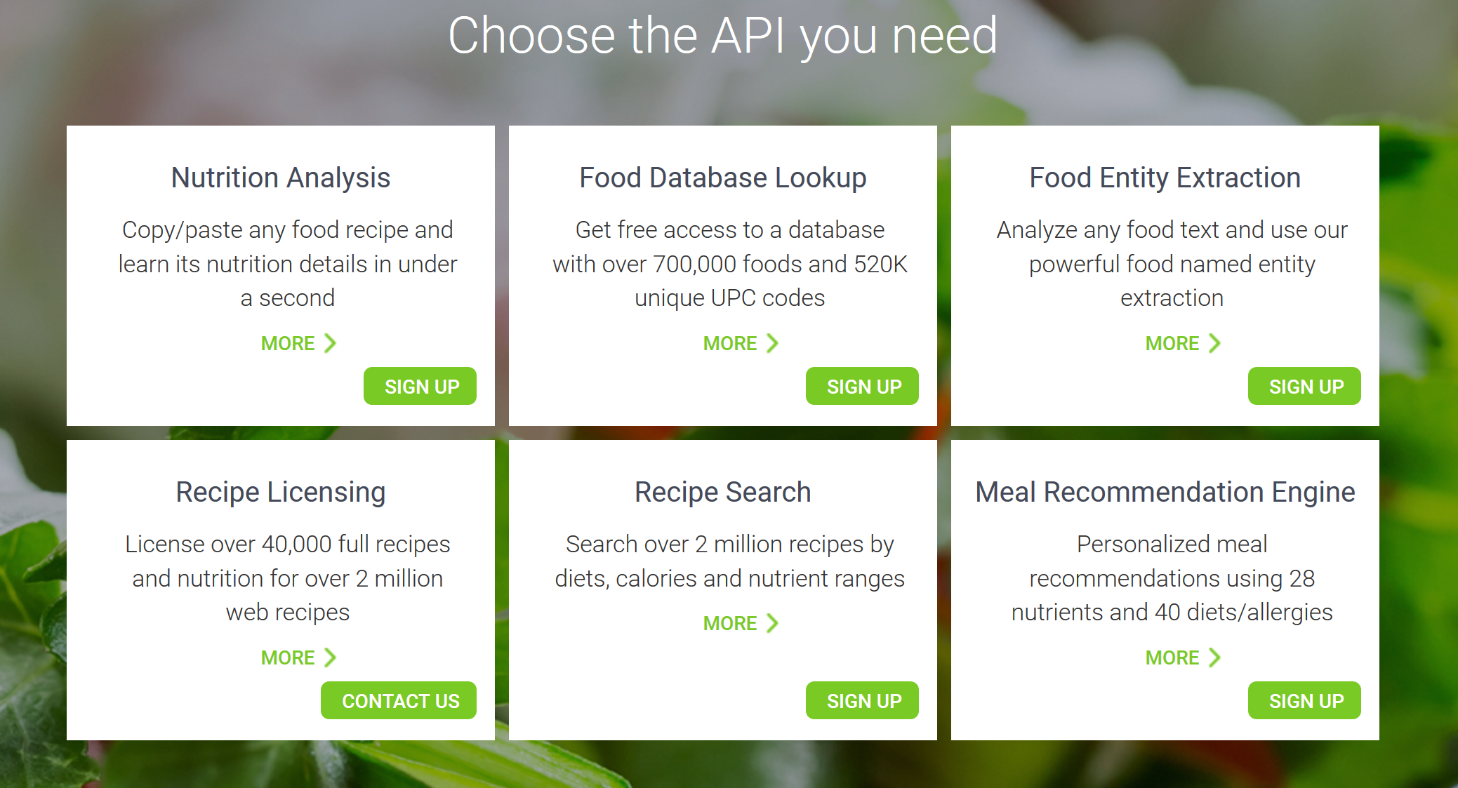
Exercise One –Recipe API
Build an API Wrapper
A ‘proxy’ to an API to simplify result
Recipe API (https://developer.edamam.com/)

Slide 69
Exercise One – Recipe API
Get a key
Create a proxy to return search results
Return name, picture, link, and calories
https://developer.edamam.com/
https://api.edamam.com/search?q=SEARCH&app_id=X&app_key=Y
Suggested npm modules: request and request-promise
Suggestion: Use secrets!
Notes:
why?
our app gets a recipe database and users have no idea who is providing it (but note, check reqs)

Slide 70
Break

Slide 71
Serverless with Webtask
Section 6 – Middleware

Slide 72
Middleware
If you’ve used middleware in Node apps – same! (Mostly)
Logic that runs before your webtask
Examples:
Authentication
Modify/prepare data
Logic that creates new compilers
Change the ‘function’ form
Bypass the ‘regular’ NodeJS compiler

Slide 73
Middleware
Specified via the editor UI or via metadata
URL, npm module, or npm module export
For URLs, result must be text!

Slide 74
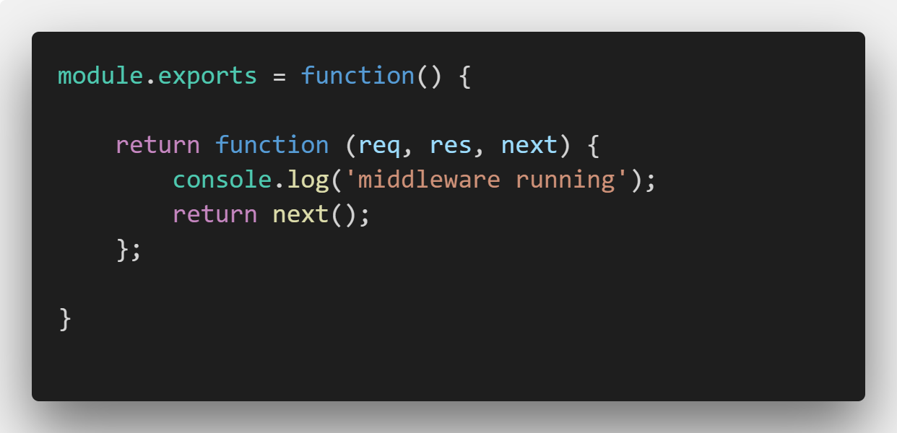
Middleware Example

Slide 75
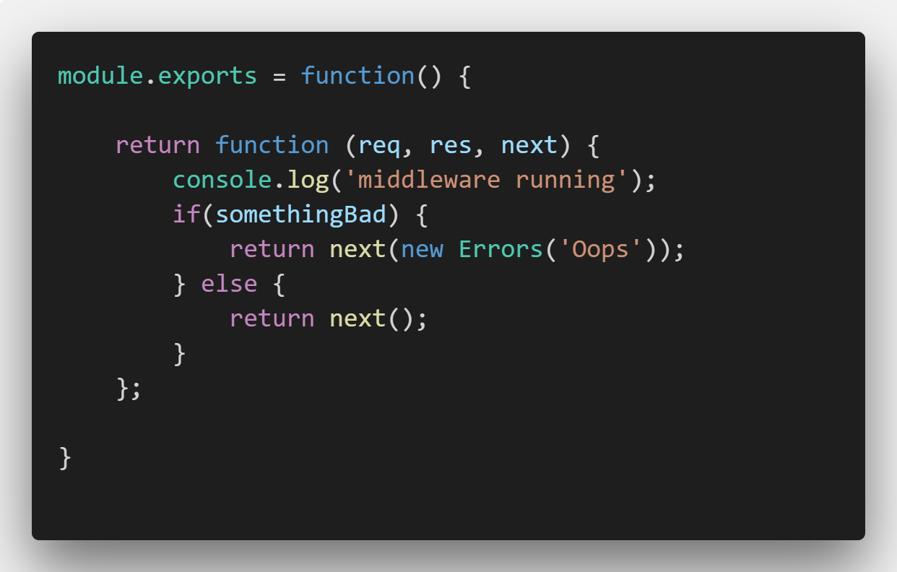
Middleware Example

Slide 76
Middleware Demo
pearson_c6_middleware1.js

Slide 77
More on Middleware
You have access to the code of the webtask: req.webtaskContext.compiler.script
You have access to a JS compiler: req.webtaskContext.nodejsCompiler
https://webtask.io/docs/middleware
https://goextend.io/blog/using-alexa-with-webtask

Slide 78
Break

Slide 79
Serverless with Webtask
Section 7 –The CLI
Notes:
Sorry for the title!

Slide 80
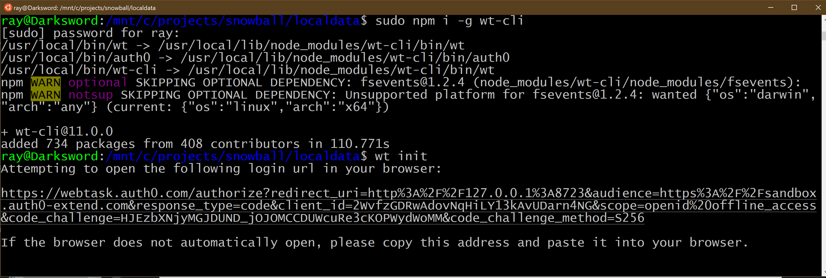

Slide 81
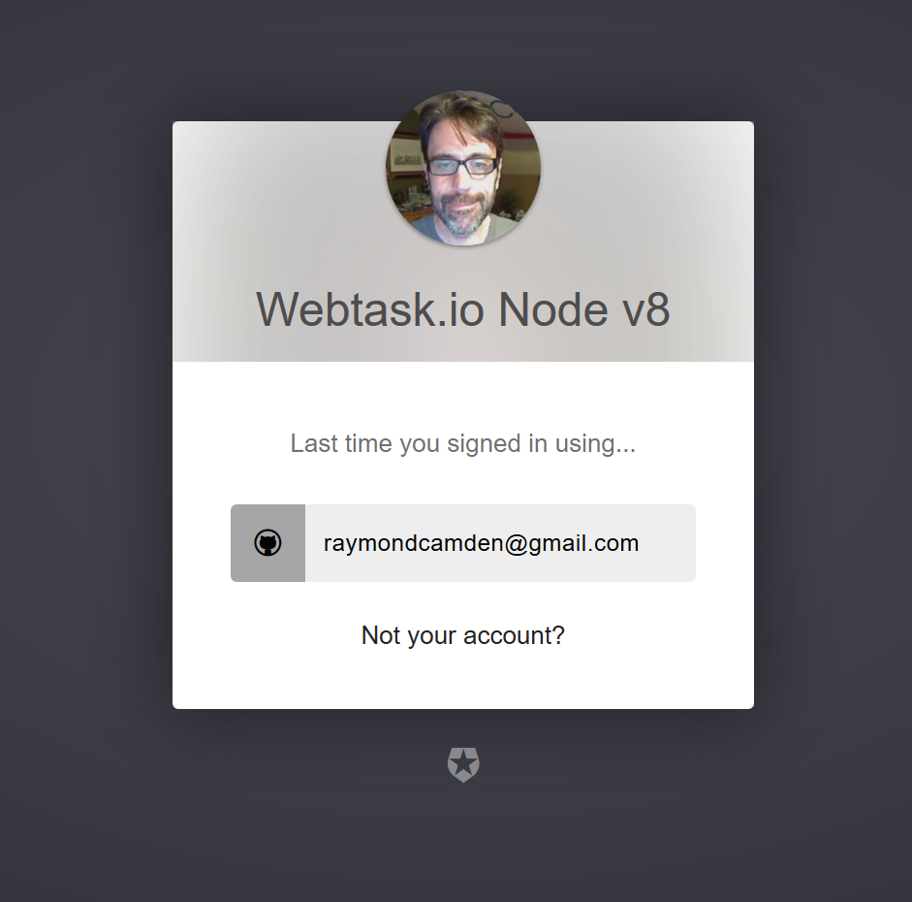

Slide 82
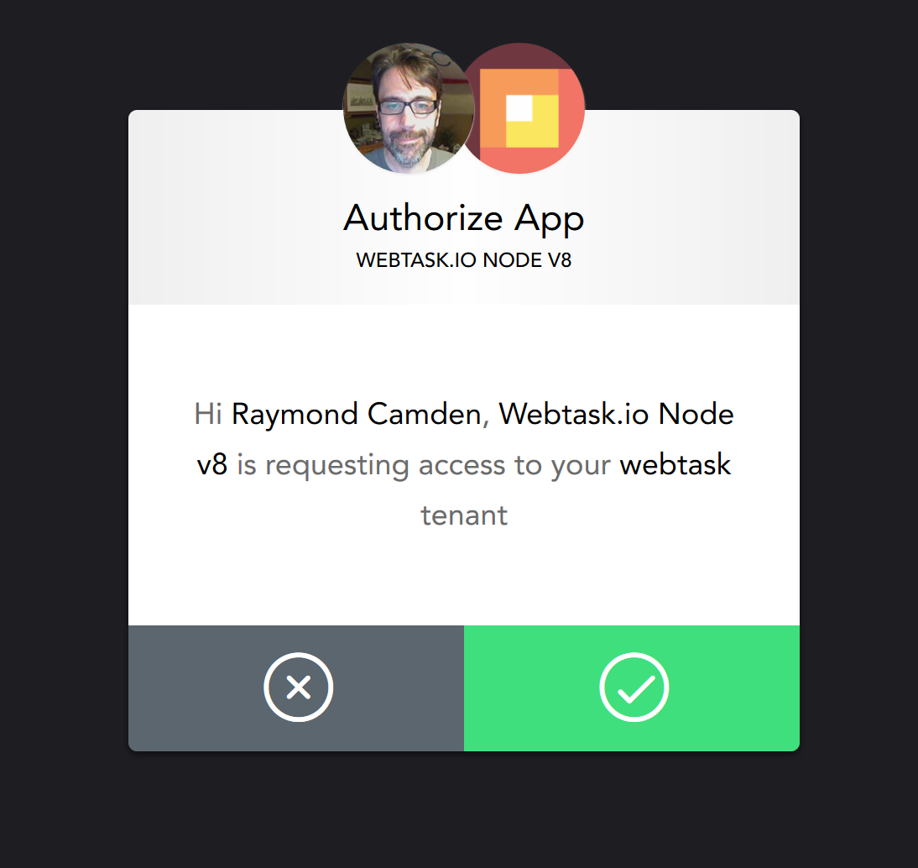

Slide 83
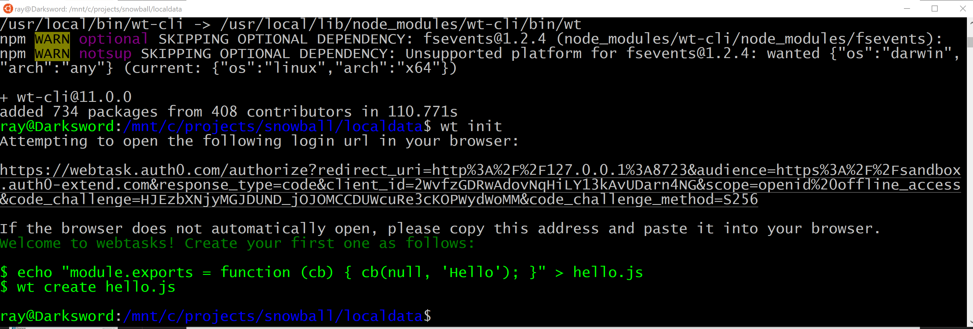

Slide 84
CLI - Basics
Listing Webtasks
Creating Webtasks
Updating Webtasks
Deleting Webtasks

Slide 85
CLI - Listing
wt ls
--limit && --offset
--details && --verbose
No search, but meta filtering (key=value)
Notes:
wt ls
wt ls --limit 5
wt ls --limit 5 --verbose

Slide 86
CLI - Creating
wt create <filename>
wt create <filename> --name <name>
wt create <filename> --watch
Lots and lots more

Slide 87
CLI - Updating
wt update
Same arguments
Just use create

Slide 88
CLI - Deleting
wt rm <name>

Slide 89
CLI - Serve
Local development server
Options for secrets, metadata, storage and more
wt serve <filename>

Slide 90
CLI - Logs
wt logs

Slide 91
CLI - Edit
wt edit <name>

Slide 92
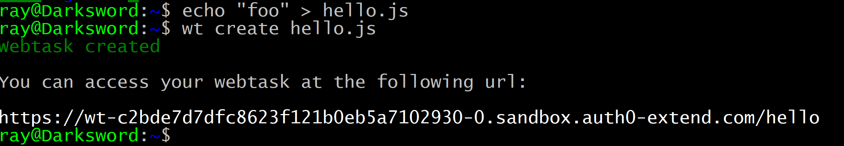

Slide 93
Serverless with Webtask
Section 8 –The Rest!
Notes:
Sorry for the title!

Slide 94
Everything Else (Mostly)
CRON (Scheduled) Webtasks
wt debug
https://nodejs.org/en/docs/guides/debugging-getting-started/
Extend (goextend.io)
https://goextend.io/docs/getting-started

Slide 95
Why NOT to use Webtask?
Results
Chaining
No upgrade path
1 request per second soft limit
30 second execution limit
10 CRON Schedules
100kb of code per task (NPM modules don’t count)
500kb of storage via Storage API
https://webtask.io/docs/limits
Notes:
wtf really?

Slide 96
Webtask Resources
Docs: https://webtask.io/docs
Slack: https://skynet.run.webtask.io/webtask-signup
Forum: https://community.webtask.io/
Blog: https://goextend.io/blog/tag/webtasks

Slide 97
Serverless Resources
Serverless Status
https://serverless.email
Serverless [Cron]icle
https://serverless.curated.co/
My own stuff:
https://www.raymondcamden.com/categories/serverless

Slide 98

Notes:
END QA

